Slide 1

Real Estate Investment Analysis for Zillow Data

Slide 2

GROUP MEMBERS
Margaret Njenga
Daphine LucaS
DIANA MBUVI
Philip Ruga.
Leon Maina
ALEX KORIR

Slide 3

BUSINESS GOAL
This project aims to identify the top 5 best states for a real estate investment firm to invest in. Our analysis will consider factors such as profit margins, risk, and time horizon to provide a comprehensive recommendation.

Slide 4

Business PROBLEM
The firm has asked us to determine the top 5 states for investment, taking into account:
Profit potential: Expected price appreciation and potential rental income.
Risk: Volatility and stability of the price forecasts.
Time horizon: Appropriate time frame for the investment (e.g., short-term, long-term).

Slide 5

Project flow
Data Understanding
Exploratory Data Analysis Univariate, Bivariate, Multi-variate
Pre-processing
Dropping null values, handling outliers
Modelling
Arima
Fit the Model and Forecasting
Interpretation, conclusion and recommendation

Slide 6

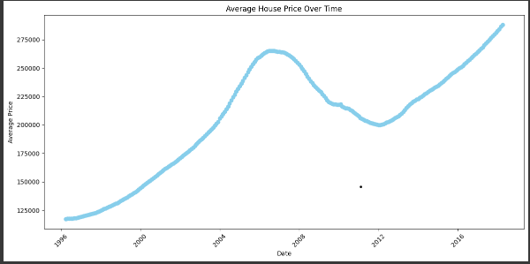
Univariate analysis
Shows a steady upward trend with a decline between 2008 and 2012 as a result of the financial crisis caused by the bursting of the housing market bubble.

Slide 7
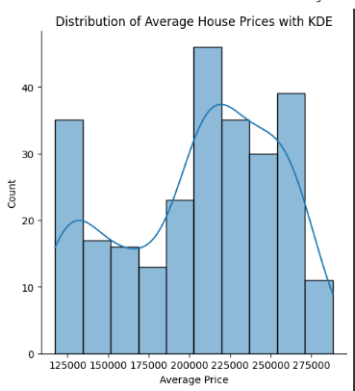
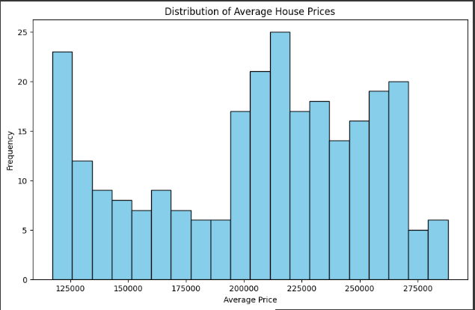
Univariate Analysis
The average house prices are not evenly distributed. There are more houses in the middle price range, and fewer houses that are very expensive or very inexpensive

Slide 8
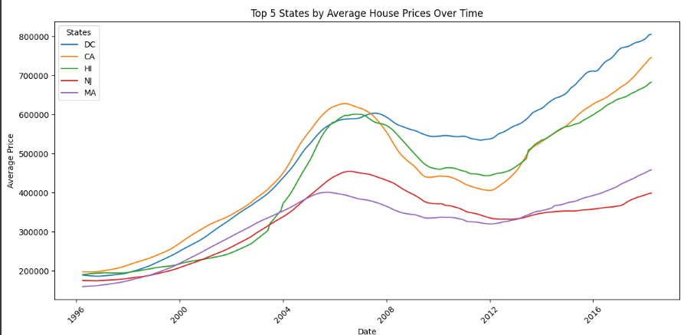
Bivariate analysis

Slide 9
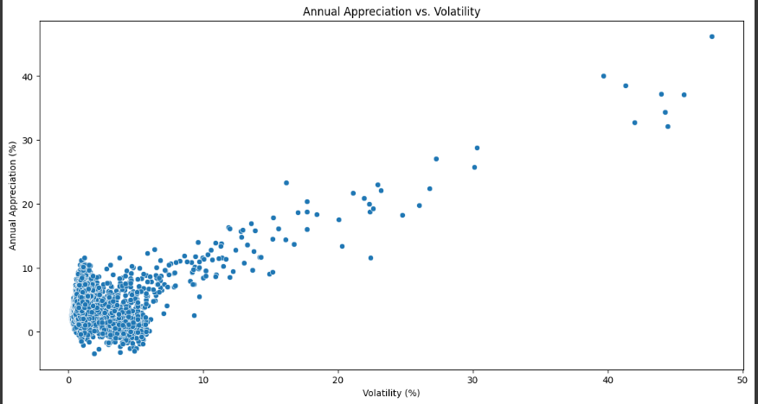
Bivariate analysis
Shows a steady upward trend with a decline between 2008 and 2012 as a result of the financial crisis caused by the bursting of the housing market bubble.

Slide 10

ANALYSIS FINDINGS
Price vs. Time:
There is a strong positive correlation between time and median sales prices across most zip codes. Some zip codes exhibit stronger growth trends compared to others.
Price vs. Region:
Certain regions, especially major metropolitan areas, consistently show higher median prices. Suburban and rural areas tend to have lower median prices but may show significant growth potential.

Slide 11
ANALYSIS FINDINGS
Price vs. SizeRank:
There is a noticeable correlation between SizeRank and median prices, with higher-ranked areas often having higher prices. This could indicate that more populous areas, which tend to have higher SizeRanks, are more valuable.
Price vs. Volatility:
Zip codes with higher median prices tend to show more volatility. This could indicate that high-value areas are subject to more significant fluctuations in market conditions.

Slide 12



ARIMA MODELLING
ARIMA -1st differencing
ARIMA -2nd differencing
ADF Statistic: -1.923520236111722
p-value: 0.3210786192180571
ADF Statistic after differencing: -1.4088495412230682
p-value after differencing: 0.5780262607919437
ADF Statistic after second differencing: -19.622168841937764
p-value after second differencing: 0.0.

Slide 13
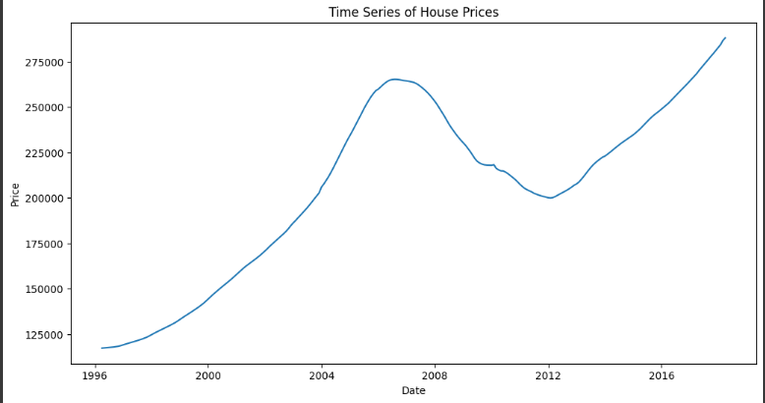
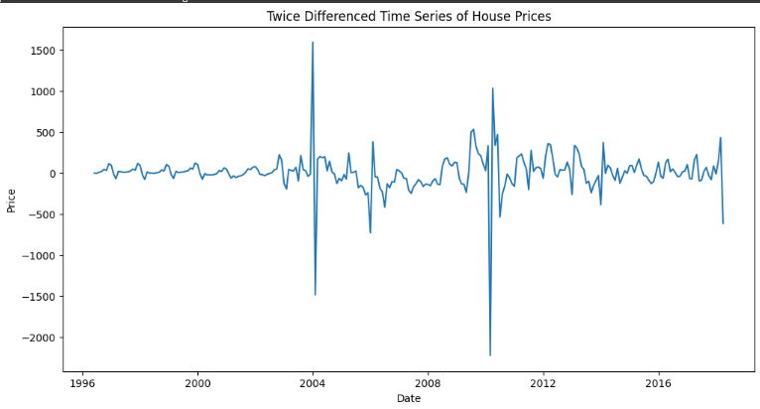
ARIMA MODELLING

Slide 14
FORECASTING FOR THE HOUSING MARKET

Slide 15

Conclusions
investment Potential:
The top 5 identified states show high potential for real estate investment based on historical price trends and forecasted growth. These zip codes balance high-profit potential with manageable risk levels, making them attractive for investment.
Risk Assessment:
Volatility analysis suggests that while some high-value areas are riskier, they offer higher returns. More stable areas provide safer investment options with moderate returns.

Slide 16

Diversified Investment: Invest in a diversified portfolio that includes high-growth, high-volatility, and stable, moderate-growth areas. This strategy will balance the potential for high returns with risk management. Long-Term Investment: Focus on long-term investment strategies in areas with strong upward trends and stable growth. Short-term investments can be considered in high-volatility areas with careful monitoring of market conditions. Continuous Monitoring: Continuously monitor market conditions and economic indicators that could impact the real estate market. Adjust investment strategies based on new data and forecasts to optimize returns and manage risks
Recommendations

Slide 17
We recommend these five states: State Washington DC California Hawaii New Jersey Massachusetts

Slide 18

Detailed Risk Analysis: Conduct a more detailed risk analysis for the top 5 states, considering factors like economic conditions, employment rates, and local developments. Scenario Planning: Develop scenario plans to understand the impact of different economic conditions on real estate prices. Use these scenarios to prepare for potential market downturns or booms. Further Model Refinement: Refine the ARIMA model by incorporating additional variables such as interest rates, employment data, and economic indicators. Explore other time series forecasting models to compare performance and improve accuracy.
NEXT STEPS

Slide 19

Thank you !

